Slide 1
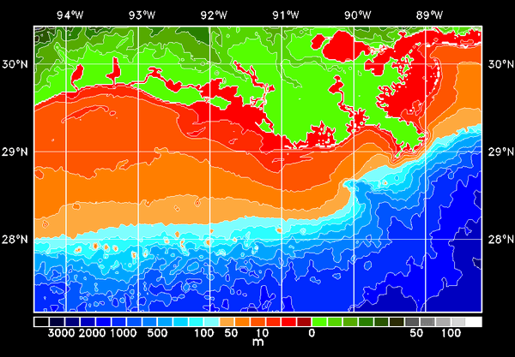
A High-Resolution 3D Hypoxia Model (GEM3D)
for the Louisiana Shelf
Dong S. Ko¹, John C. Lehrter², Michael C. Murrell², Richard M. Greene², Richard W. Gould¹, and Bradley Penta¹
¹ Naval Research Laboratory, Stennis Space Center, MS 39529
² U.S. EPA, 1 Sabine Island Drive, Gulf Breeze, FL 32561
Louisiana
Forum for Gulf of Mexico Hypoxia Research Coordination and Advancement
17-18 April 2013, Stennis Space Center, Mississippi
Notes:
Support comes from EPA

Slide 2
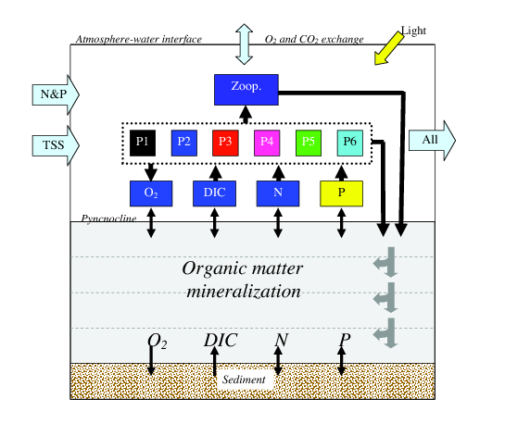
EPA General Environment Model (GEM)
Peter M. Eldridge and Daniel L. Roelke (2010, Ecological Modeling)
Consists of a plankton food web model that has 6 phytoplankton groups
and 1 zooplankton group
A multi-element diagenetic model that traces oxygen, nitrogen, phosphate,
carbon and various organic matters with exchange of O₂ and CO₂ at surface
Notes:
GEM3D is an integration of EPA GEM and 3D high-resolution coastal circulation model IASNFS-LCS

Slide 3
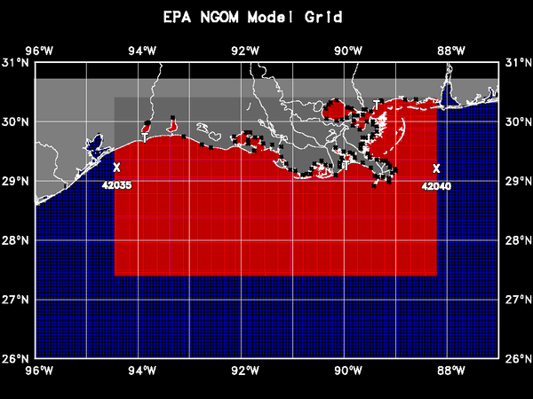
IASNFS-LCS Circulation Model
A fine resolution (~2 km/34 layers) fully 3D circulation model based on NCOM
Nested in the Intra-Americas Sea Nowcast/Forecast System (IASNFS)
95 Rivers with real-time runoff
Ko, D.S., R.H. Preller, and P.J. Martin, 2003: An Experimental Real-Time Intra Americas Sea Ocean Nowcast/Forecast
System for Coastal Prediction, Proceedings, AMS 5th Conference on Coastal Atmospheric & Oceanic Prediction &
Processes, 97-100.
Ko, D.S., P.J. Martin, C.D. Rowley, and R.H. Preller, 2008: A real-time coastal ocean prediction experiment for MREA04,
J. Marine Systems, 69, 17-28, doi:10.1016/j.jmarsys.2007.02.022.
Lehrter J.C. , D.S. Ko, M.C. Murrell, R.M. Greene, J.D. Hagy, B.A. Schaeffer, R.W. Gould, B. Penta, 2013: Nutrient
transports and source/sink dynamics on the inner Louisiana continental shelf, J. Geophy. Res., submitted.
Notes:
IASNFS-LCS cover Louisiana Continental Shell and is nested in large scale IASNFS

Slide 4
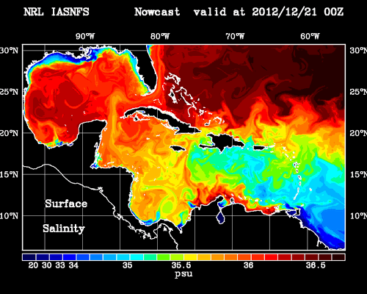
Intra-Americas Sea Nowcast/Forecast System (IASNFS)
From 2003 up-to-date
Longitude : 98 W – 55 W; Latitude : 5 N – 31 N
Horizontal Resolution : 1/24 Degree (~ 6 km)
Vertical Resolution : 40 Layers (19 Layers on the shelf)
140 Rivers with real-time river discharge
http://www7320.nrlssc.mil/IASNFS_WWW
Notes:
IASNFS provides IASNFS-LCS with boundary conditions. IASNFS is in real-time operation at NRL since 2003.

Slide 5
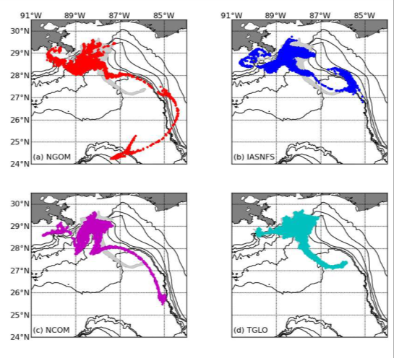
Predicted particle distributions for 20 May initialized from 17 May satellite analysis (shown in gray) using surface currents from (a) NOAA NGOM model, (b) NRL IASNFS model, (c) NAVO Global NCOM model, and (d) TGLO model.
Notes:
During 2010 oil spill, IASNFS provides daily forecast to NOAA for oil trajectory prediction.

Slide 6
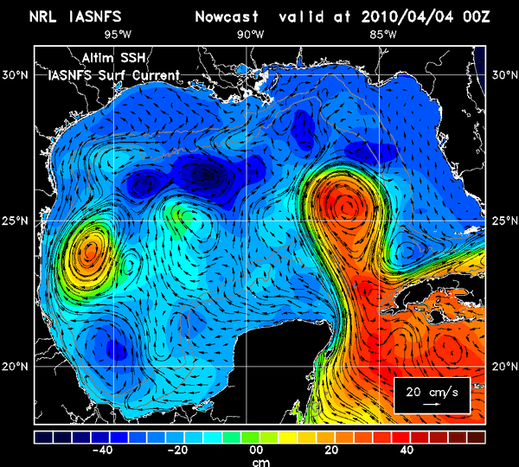
IASNFS Current over Altimeter SSH
IASNFS Current (5-day average) is consistent with Altimetry
Notes:
IASNFS current is consistent with altimeter ssh, predicting Loop Current/Loop Current eddies.

Slide 7
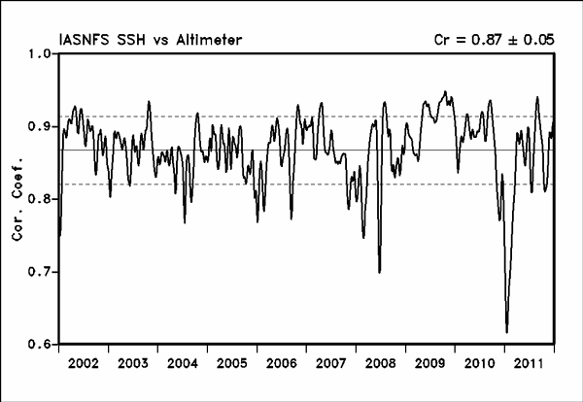
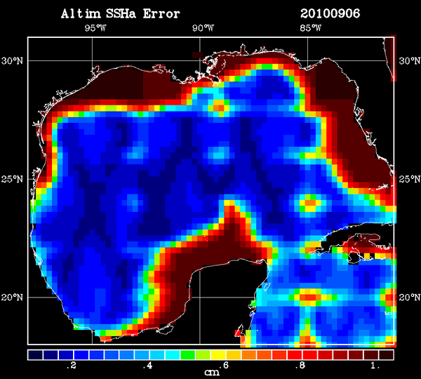
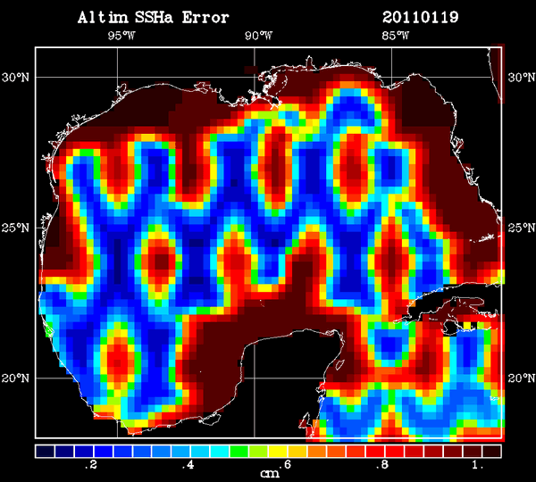
IASNFS SSHa vs Altimetry Analysis
In deep water > 500m
Overall very good correlation except during the period when altimetry analysis has large errors
Altimetry analysis
relative error
Blue: small error
Dark red: large error
Notes:
Good correlation with altimeter ssh Cr = .87

Slide 8
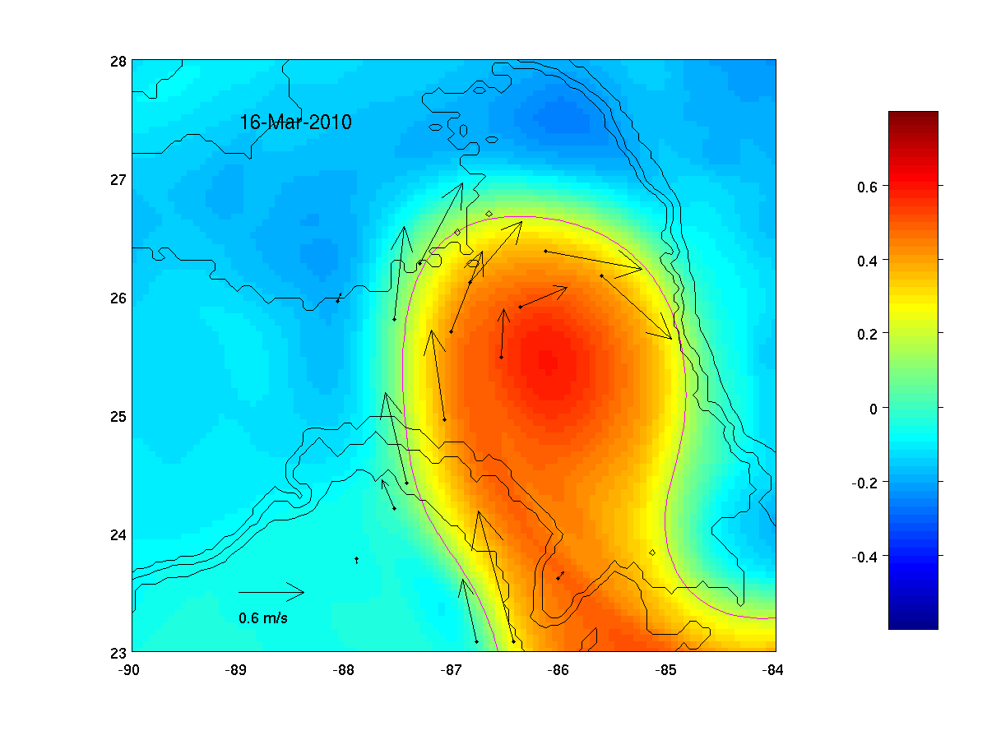
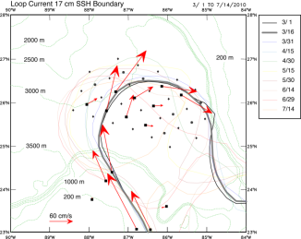
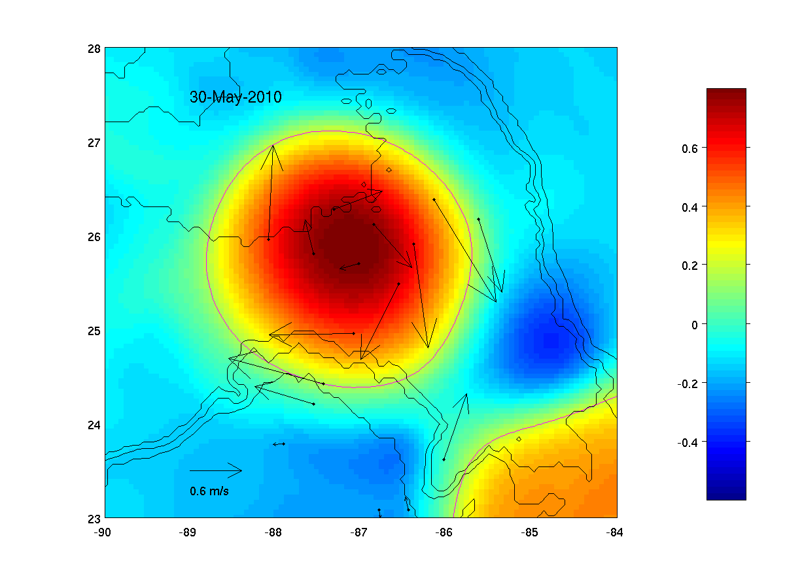
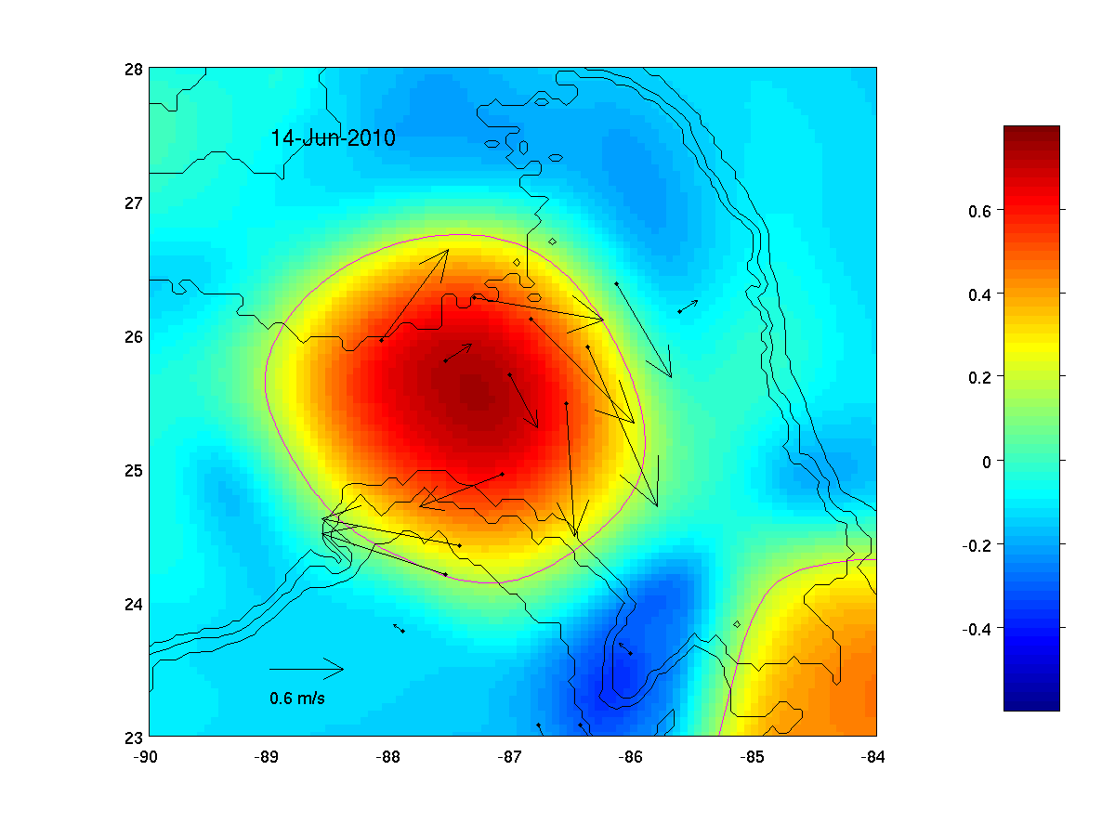
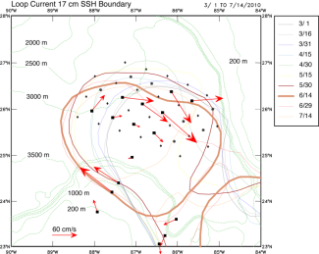
IASNFS Currents vs Mooring Observation
Notes:
Good comparison of current with BOEM mooring measurements

Slide 9
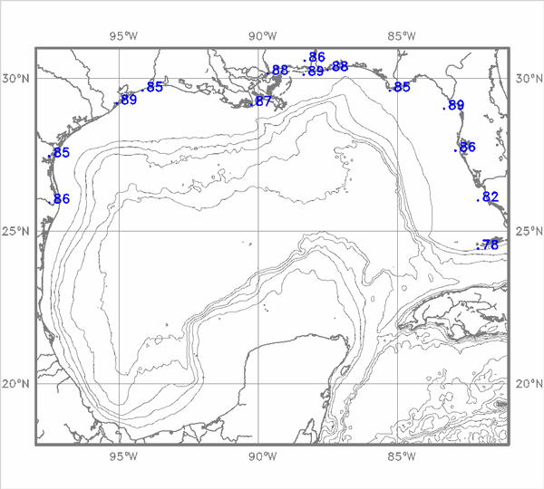
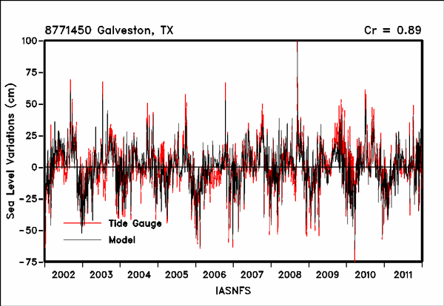
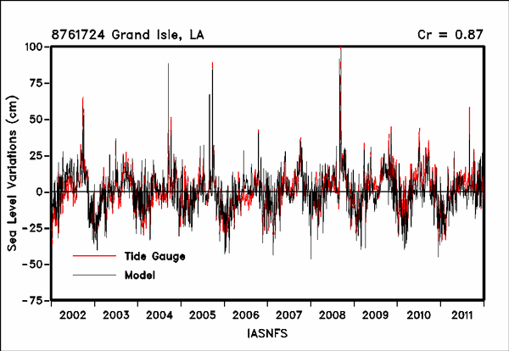
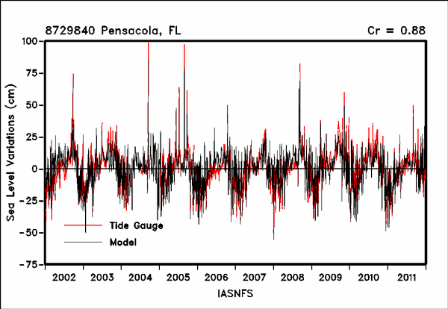
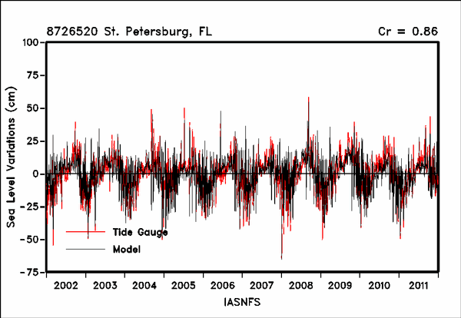
IASNFS SSH Variation vs NOS Tide Gauge
Overall very good correlation
Altimetry analysis
relative error
Notes:
Very good correlation with NOS tide gauge sea level variation

Slide 10
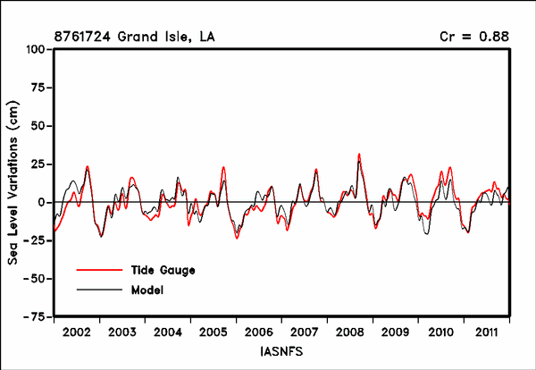
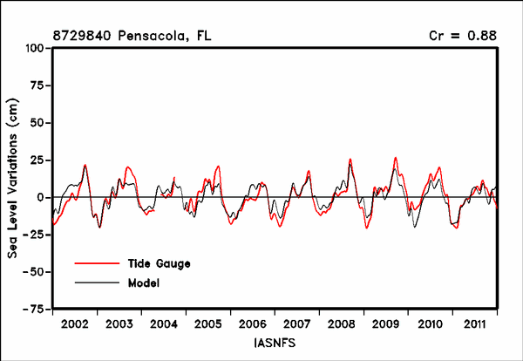
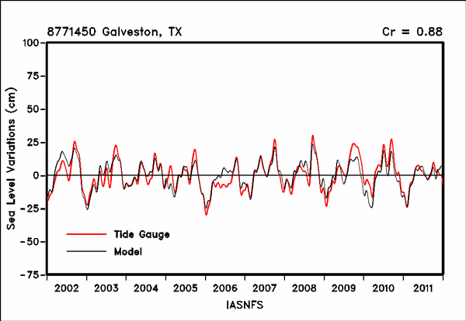
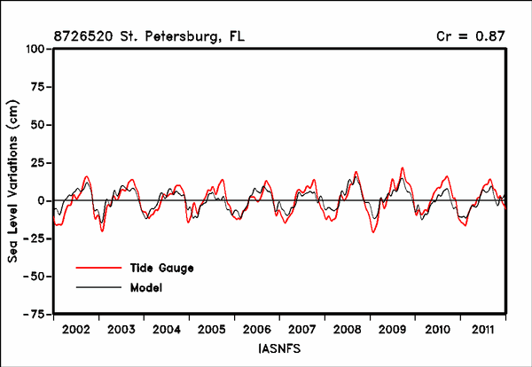
IASNFS SSH Variation vs NOS Tide Gauge
Monthly
Notes:
Good correlation with tide gauge in seasonal scale

Slide 11
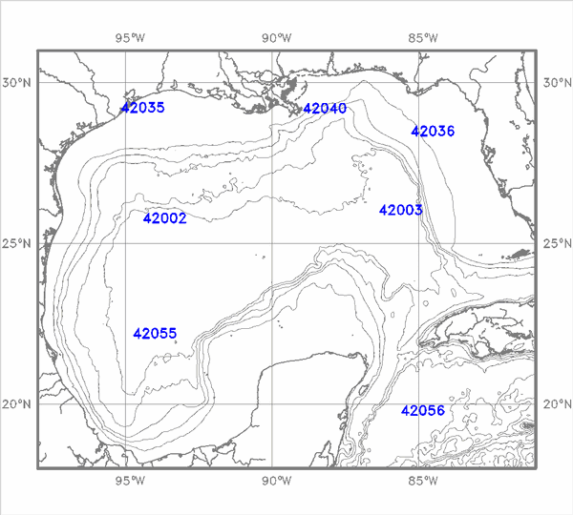
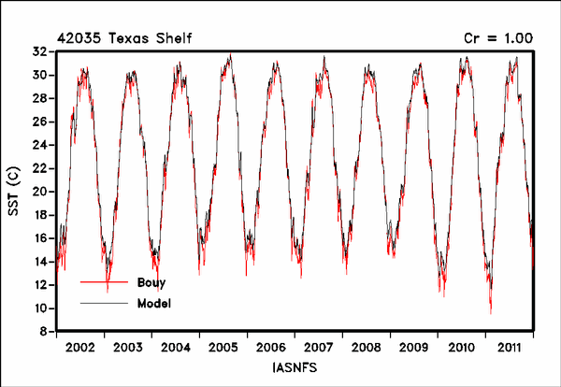
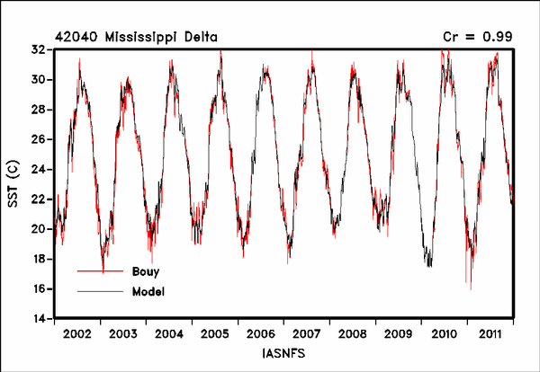
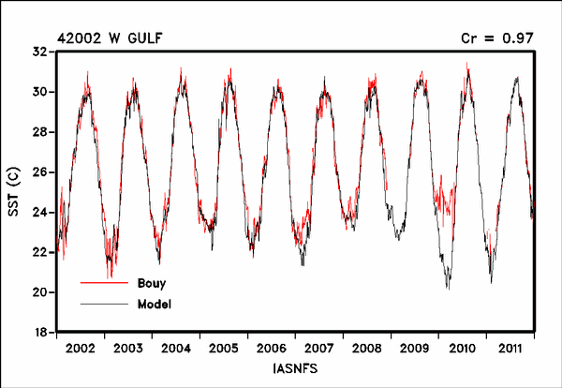
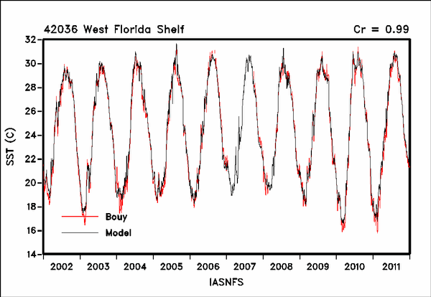
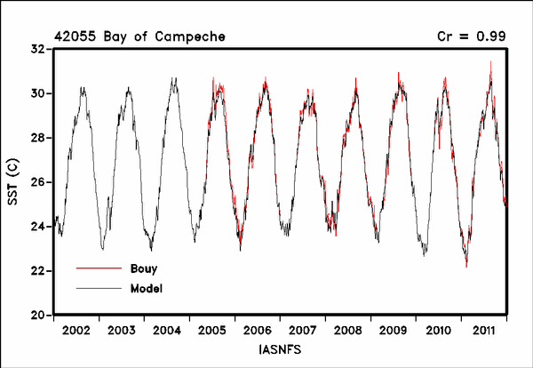
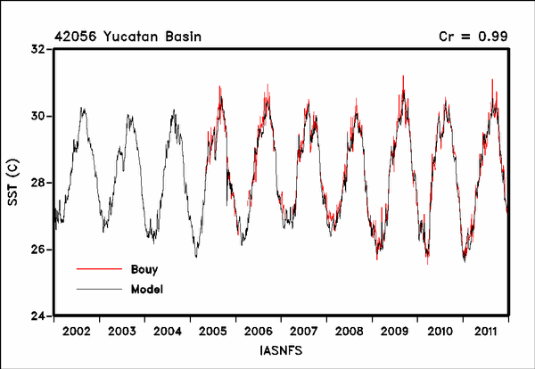
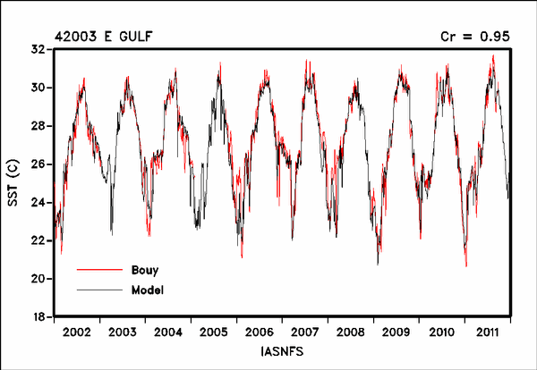
IASNFS SST vs NDBC Buoy
Very good correlation
Altimetry analysis
relative error
Notes:
Very good comparison with NDBC buoy sst in the Gulf of Mexico

Slide 12
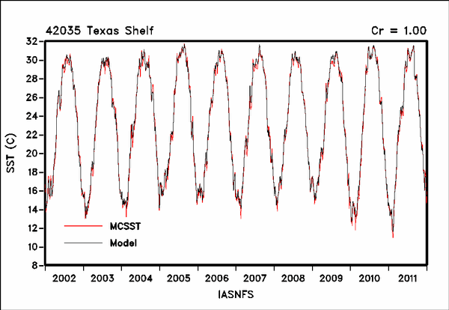
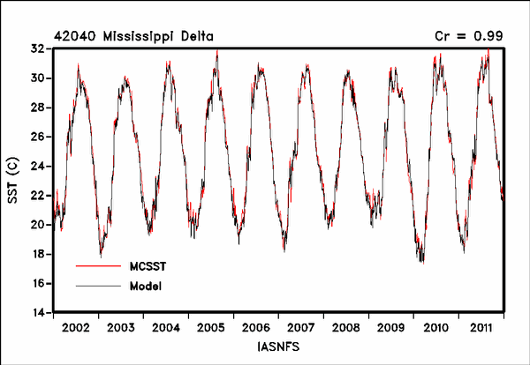
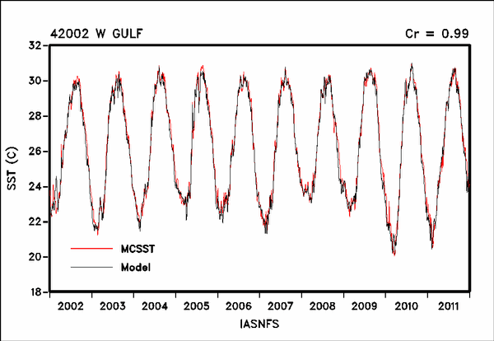
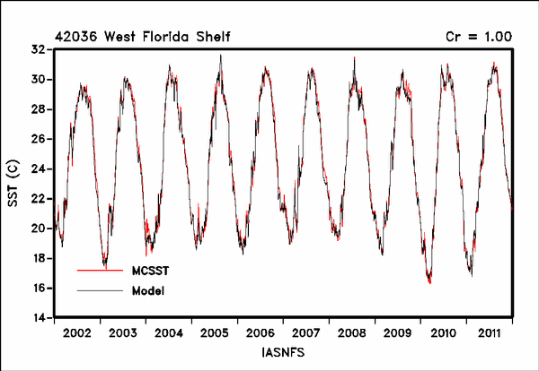
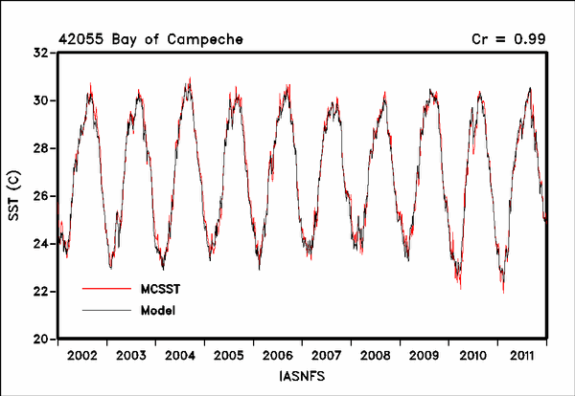
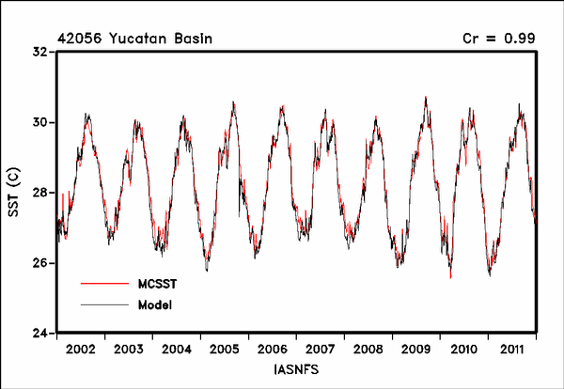
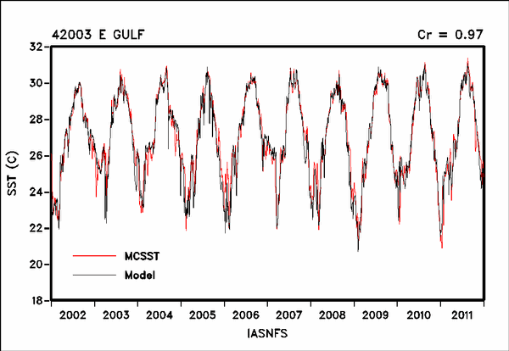
IASNFS SST vs MCSST
Very good correlation
Altimetry analysis
relative error
Notes:
Very good comparison with MCSST

Slide 13
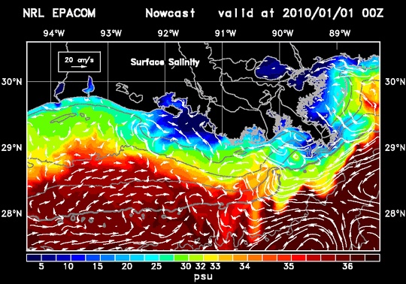
IASNFS-LCS Simulation
From 2002 to 2012
Surface Salinity
http://www7320.nrlssc.navy.mil/IASNFS_WWW/EPANFS_WWW/
Notes:
IASNFS-LCS simulation

Slide 14
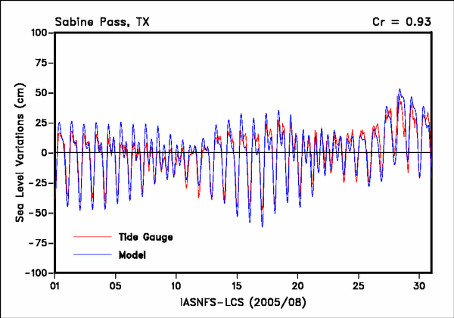
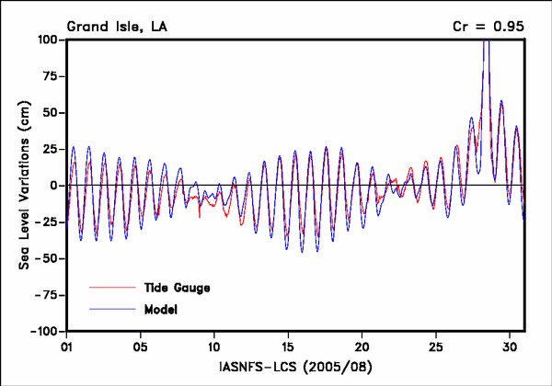
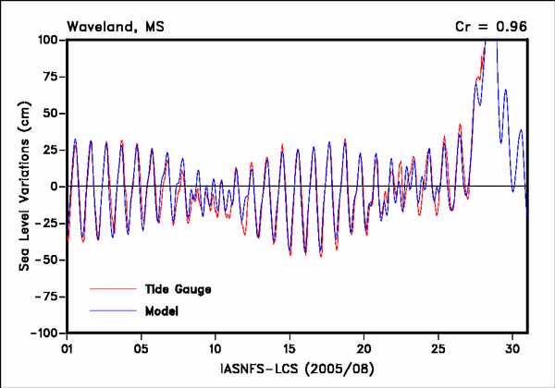
IASNFS-LCS Tides vs NOS Tide Gauge
Notes:
Good correlation in tides

Slide 15
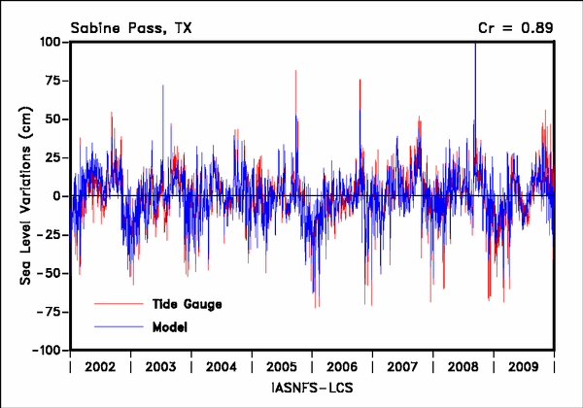
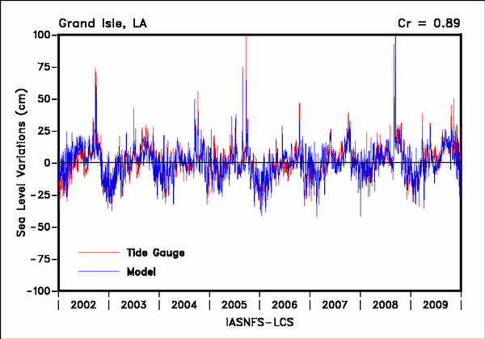
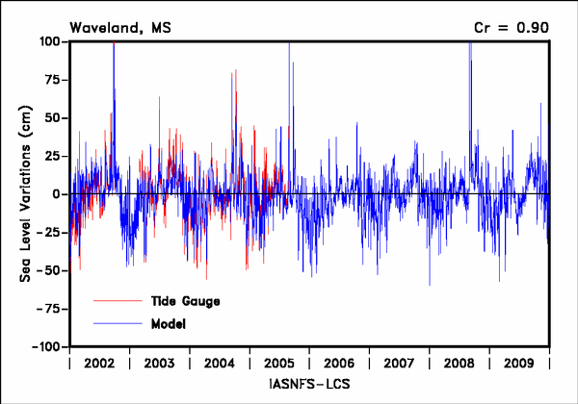
IASNFS-LCS Tides vs NOS Tide Gauge
Notes:
Good correlation in sub-tidal wind-driven sea level variation

Slide 16
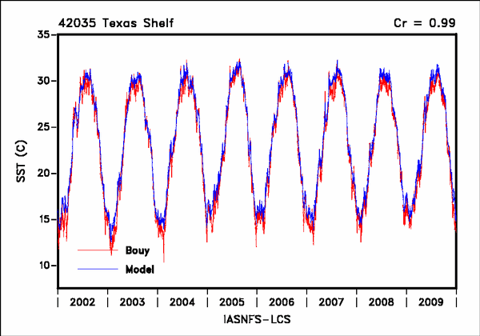
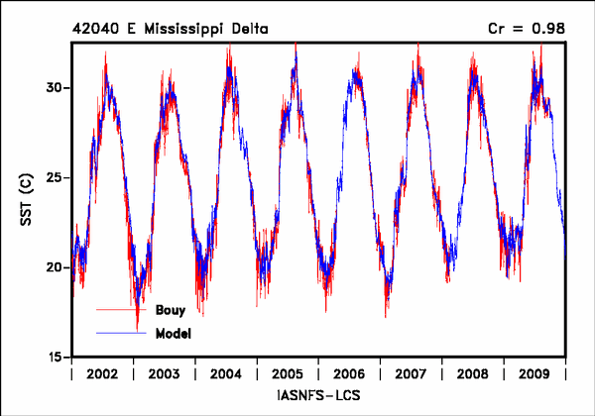
IASNFS-LCS SST vs NDBC Bouy
Notes:
Very good correlation with NDBC sst measurement

Slide 17
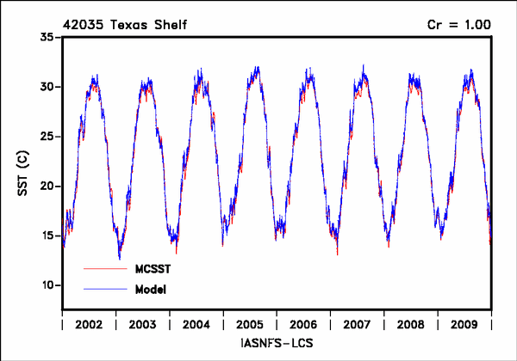
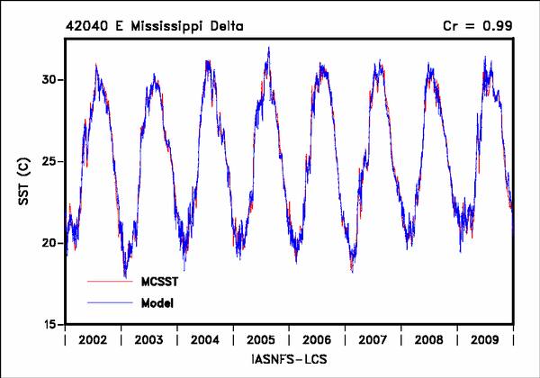
IASNFS-LCS SST vs MCSST
Notes:
Very good correlation with MCSST (short-time variation is reduced)

Slide 18
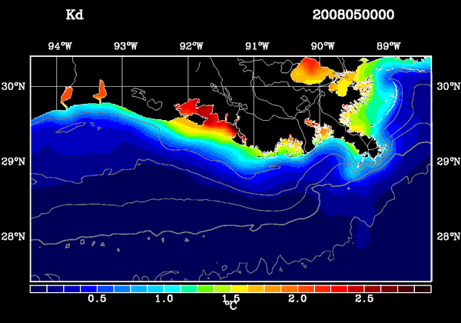


IASNFS-LCS Simulation with Kd
Kd from
SeaWiFS/MODIS
Without Kd
Temperature
With Kd
Temperature
Notes:
Use Kd from SeaWiFS/MODIS to improve temperature prediction

Slide 19


IASNFS-LCS Simulation with E-P
RMSE = 1.4
RMSE = 0.7
1:1
1:1
Precipitation from TRMM
Evaporation from COAMPS
Notes:
Use rainfall from TRMM to improve salinity prediction

Slide 20



IASNFS-LCS Simulation with E-P
Without E-P
Salinity
With E-P
Salinity
Notes:
Difference in salinity prediction with/without TRMM rainfall

Slide 21
IASNFS-LCS Simulation with E-P/Kd
RMSE = 1.4
RMSE = 0.7
1:1
1:1
Without E-P/Kd
RMSE =1.09
RMSE = 0.55
1:1
1:1
With E-P/Kd
Notes:
The salinity prediction improve somehow with TRMM

Slide 22




IANFS-LCS Simulation - Flow Pattern
Monthly Mean Current (vectors) & EKE (colors)
Notes:
Overall IASNFS-LCS simulation shows correct seasonal flow pattern

Slide 23




IASNFS-LCS Simulation - Stratification
Seasonal Stratification On the Louisiana Shelf
(Brunt-Vaisala / Buoyancy Frequency)
Notes:
And seasonal stratification

Slide 24

GEM3D Simulation – Riverine OM
Horizontal Variation due to River Runoff, Settling,
3D Current Advection and Vertical Mixing
Notes:
All 30 variables in the GEM3D are subjected to 3D advection (with sinking) and vertical mixing over more than 1 million grids every time step (300s).

Slide 25

GEM3D Simulation of Plankton Dynamics
Vertical Variation is also due to Migration, Growth, Death and
3D Advection by the Current
Light
Phytoplankton
Zooplankton
Depth
Day-Night Variation
Zooplankton
Notes:
With high vertical resolution, an improved plankton dynamics

Slide 26

GEM3D Simulation - Phytoplankton
Total (Monthly Average)
Initialized with NOAA NODC monthly DIN, DIP and DO climatology
The monthly climatology is also used for the open boundary conditions
Real-time daily river runoff from USACOE/USGS

Slide 27

GEM3D Simulation - Phytoplankton
Total 6 Groups

Slide 28

GEM3D Simulation - DIN

Slide 29

GEM3D Simulation - OM at Bottom
Daily

Slide 30

GEM3D Simulation – OM
3 Groups

Slide 31

GEM3D Simulation - Bottom Water DO
Daily

Slide 32

GEM3D Simulation - Bottom Water DO
Monthly Average

Slide 33

GEM3D Simulation - DO

Slide 34

EPA-GEM3D Simulation - Area of Bottom Water Hypoxia
Each Season from 2003 to 2012
km²
Comparison of Observation to the model predicted area of bottom water hypoxia that is persistent over 10 days or over 15 days for the season.
The observed area of bottom water hypoxia is an estimation based on ship surveys. The estimation for 2011 is 17,548 km² (LUMCON). For 2012 is 7,480 km² (Jul 27).
For 2010, the hypoxic zone is in part located at Texas shelf out of model domain.
Observation

